Slide 1
Towards the Perfect Blog Post
Bryan Ross

Slide 2

IMPORTANCE
Why TDS?
COMMUNITY
EXPOSURE
MEDIUM PARTNER PROGRAM

Slide 3







METHODS
SCRAPE
PROCESS
MODEL
EXTRACT

Slide 4

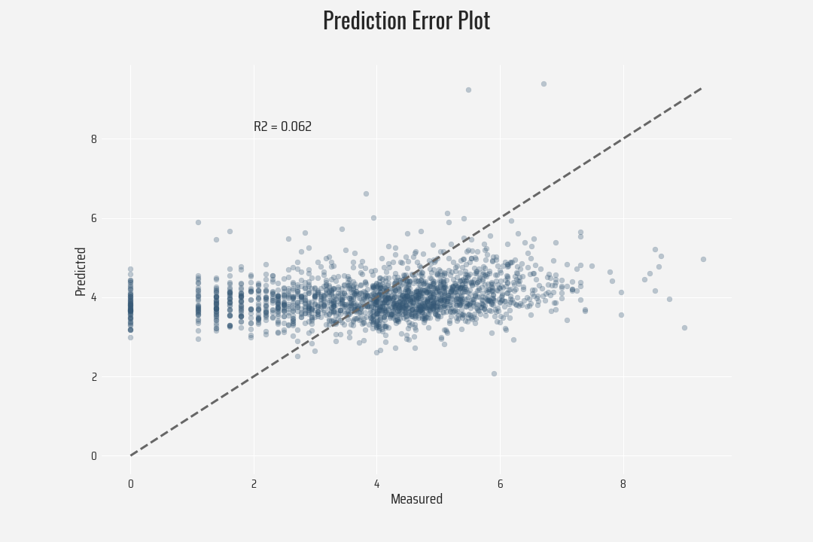
CAUTION

Slide 5
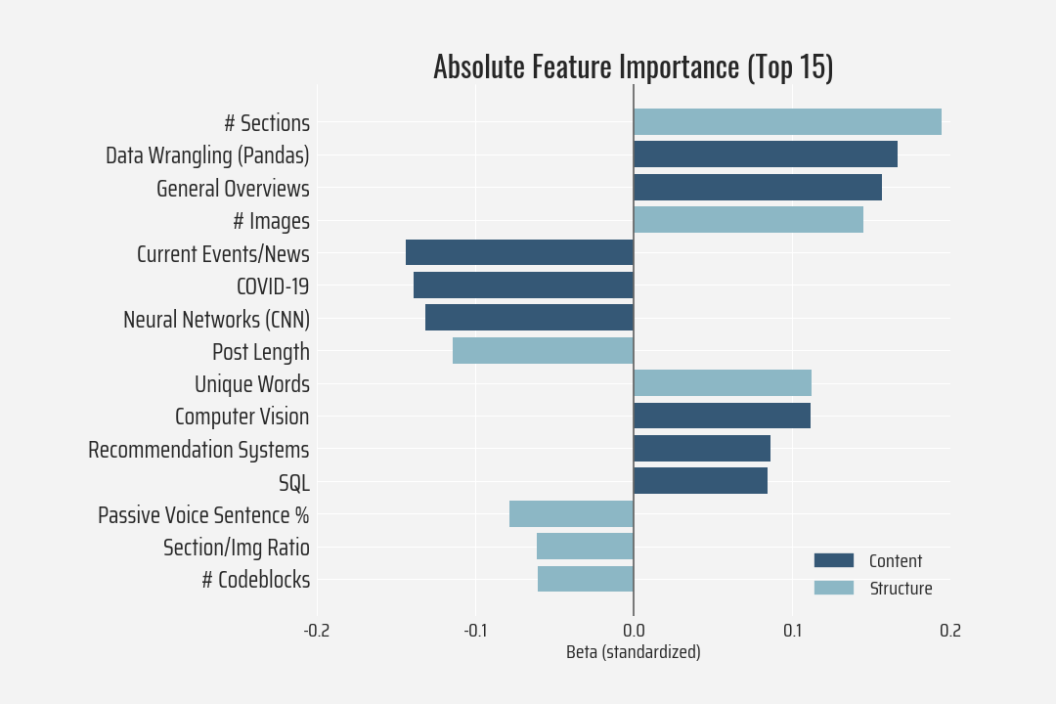
FEATURE IMPORTANCE
BOTH CONTENT AND STRUCTURE MATTER

Slide 6
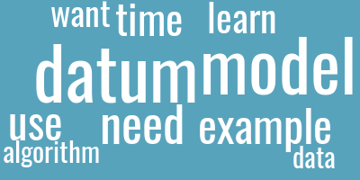

TOPIC EXAMPLES
General Overviews
COVID-19

Slide 7
CONCLUSIONS
Takeaways
Avoid long blocks of text, include visuals
Use active voice, vary vocabulary
Tutorials > reporting
But…model needs more data

Slide 8
THANK YOU!

Slide 9
APPENDIX
APPENDIX

Slide 10
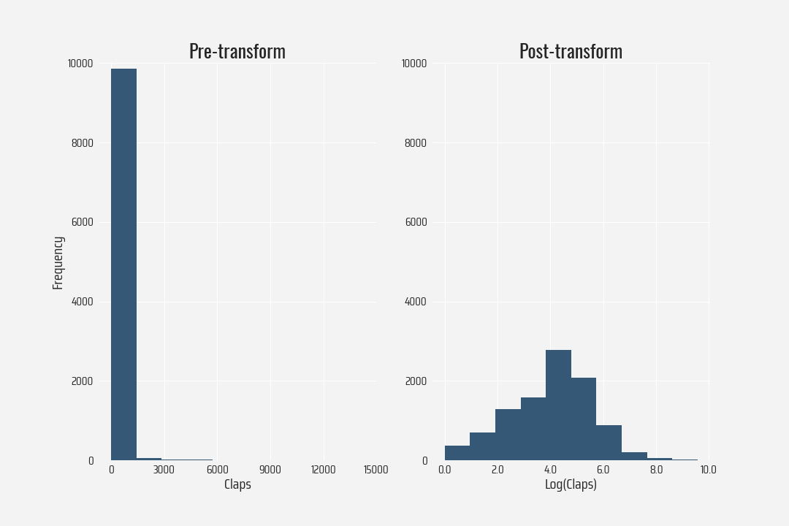
APPENDIX

Slide 11
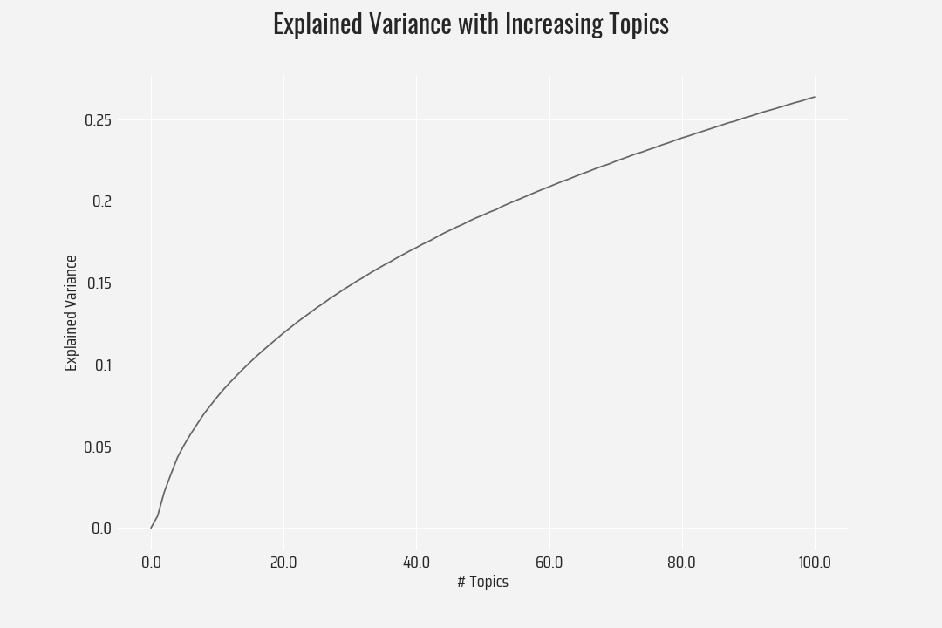
APPENDIX

Slide 12
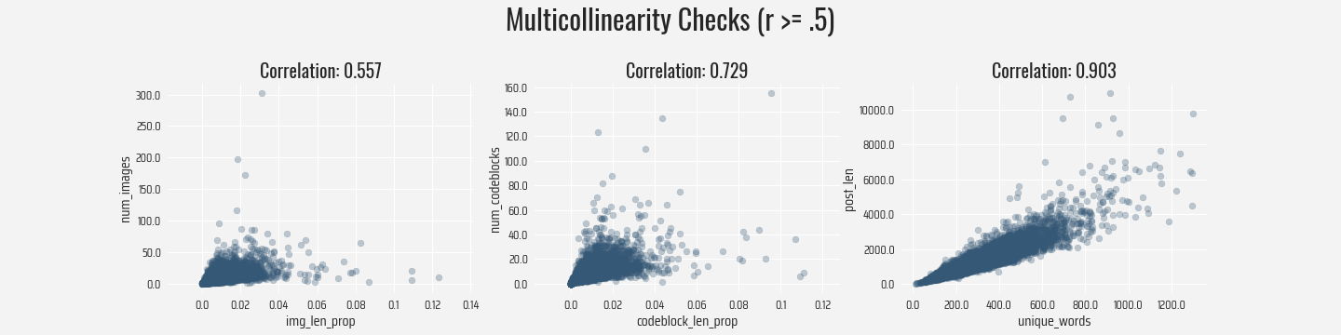
APPENDIX

Slide 13
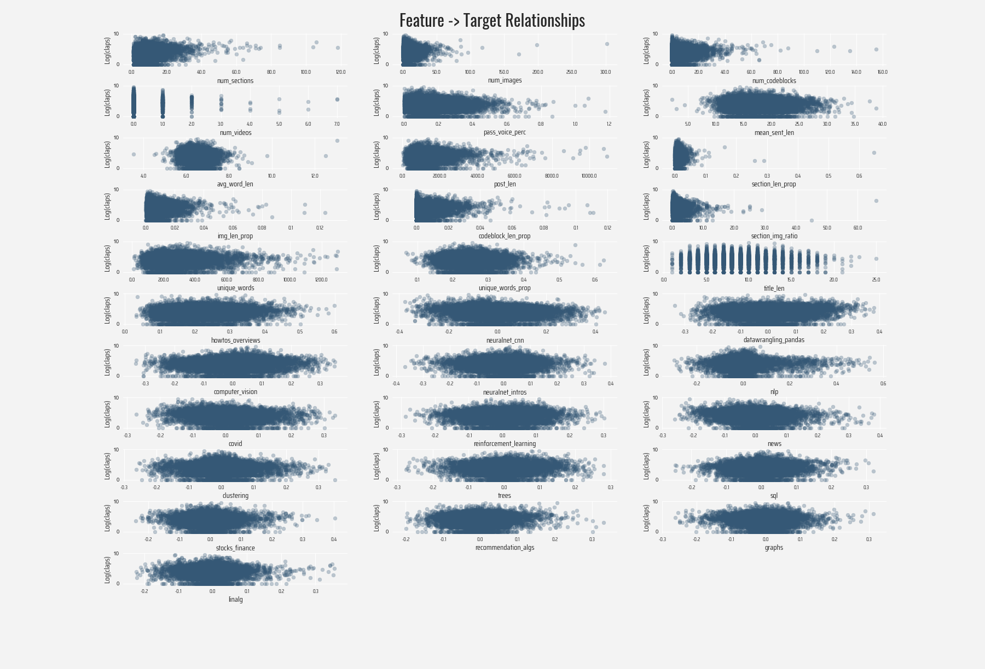
APPENDIX

Slide 14
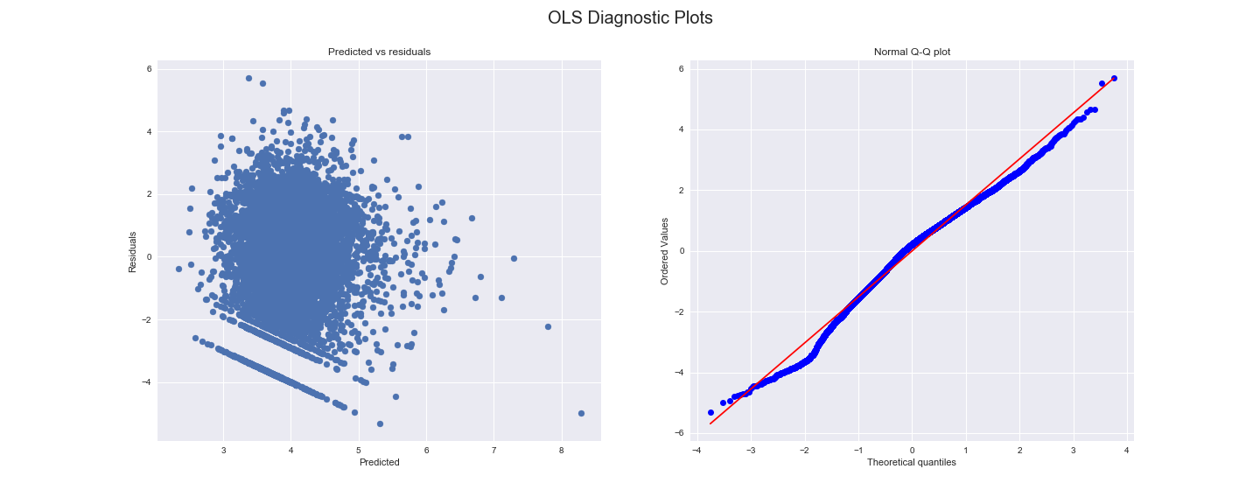
APPENDIX

Slide 15
CREDITS
CREDITS
Presentation template by Slidesgo
Icons by Flaticon
Infographics by Freepik
Images created by Freepik
Author introduction slide photo created by Freepik
Text & Image slide photo created by Freepik.com

